Slide 1
Experience with Cavity Performance: Changes from Vertical to Cryomodule Test
Dan Gonnella
Nicholas Valles, Matthias Liepe
Cornell University

Slide 2
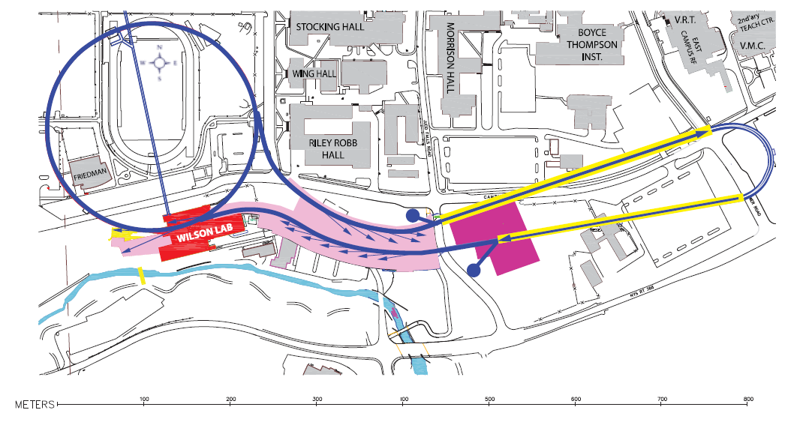
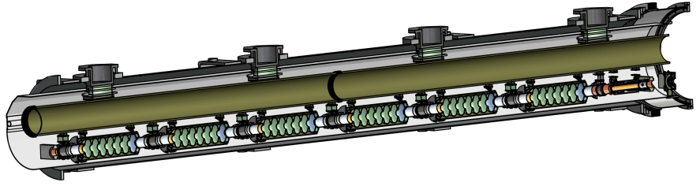
Motivation: The Cornell ERL
LINAC-A
CESR
Injector
LINAC-B
Beam Stop

Slide 3
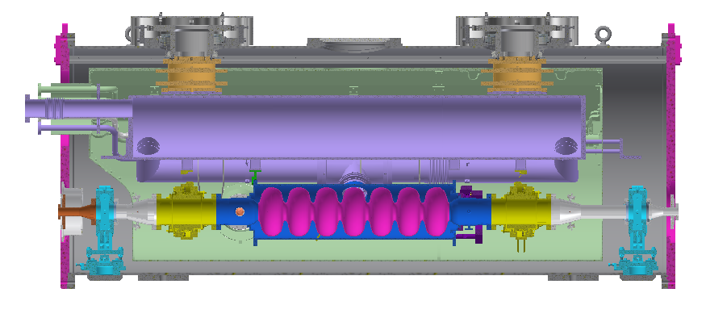
Purpose of HTC Tests
Main Linac Cryomodule
Horizontal Test Cryomodule (HTC)

Slide 4
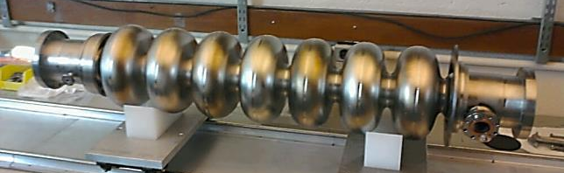
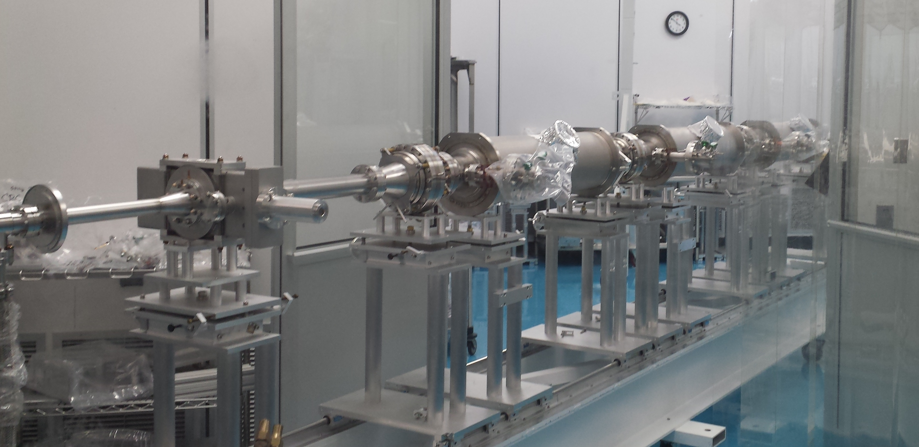
Cavity Fabrication and Vertical Test
Fabricated with 85% field flatness
CMM results show that we achieved ¼ mm shape precision after welding
Tuned to 95% field flatness
6 additional cavities have been fabricated.
String Assembly for the prototype main linac cryomodule has begun.
Cavity preparation:
Bulk BCP + 650ºC Heat Treatment + Light BCP + 120ºC Bake + HF Rinse

Slide 5
Vertical Test Results
1.8 K
ERL7-2 has been reprocessed
ERL Spec
Q₀
ERL7-1 achieved Q₀ of 1.7x10¹⁰ at 1.8 K and 16 MV/m in vertical test.
Note: HF rinse was added to the recipe after the first vertical test.
E_{acc} [MV/m]
Plot courtesy of F. Furuta

Slide 6
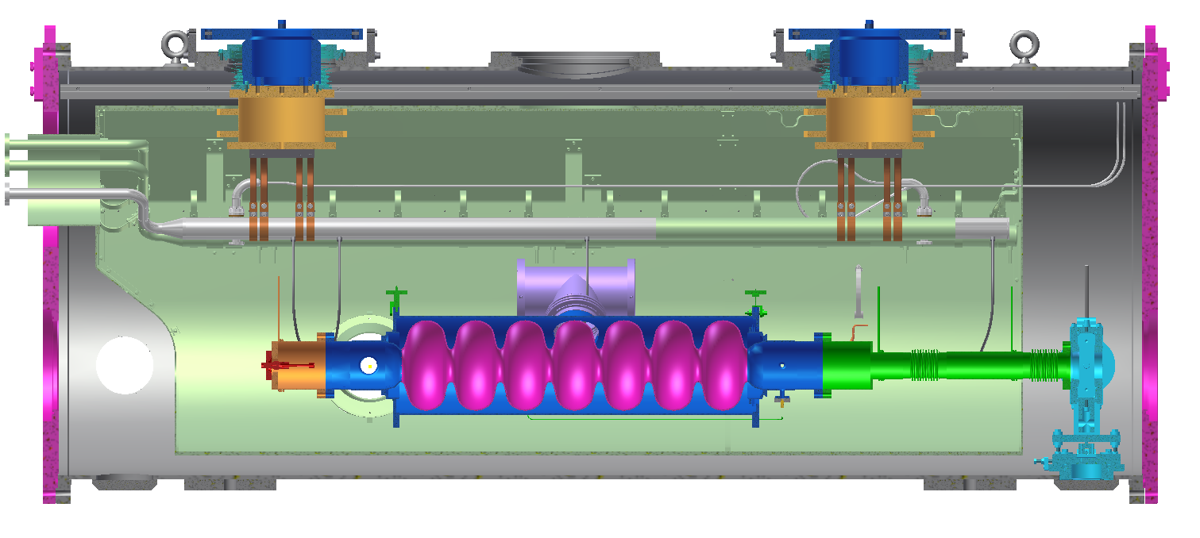
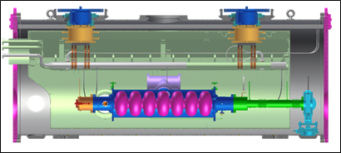
3 HTC Tests
HTC-1: Follow vertical assembly procedure as closely as possible
HTC-2: Include side mounted, high power RF input coupler
HTC-3: Full cryomodule assembly-high power RF input coupler and beam line HOM loads

Slide 7
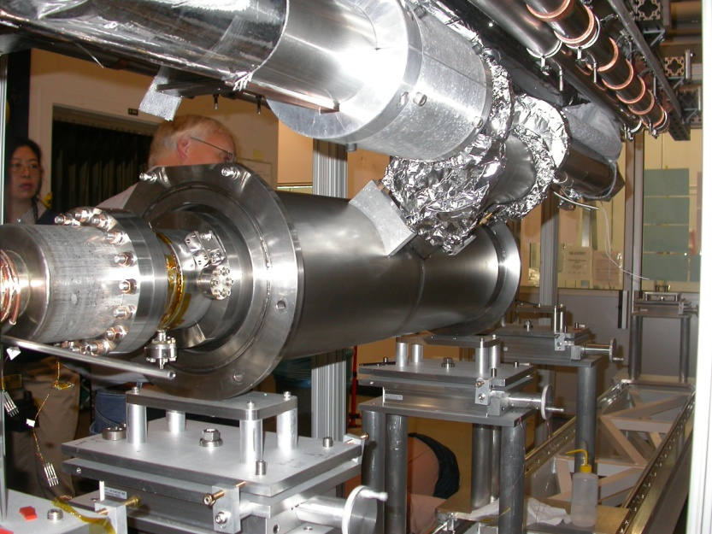
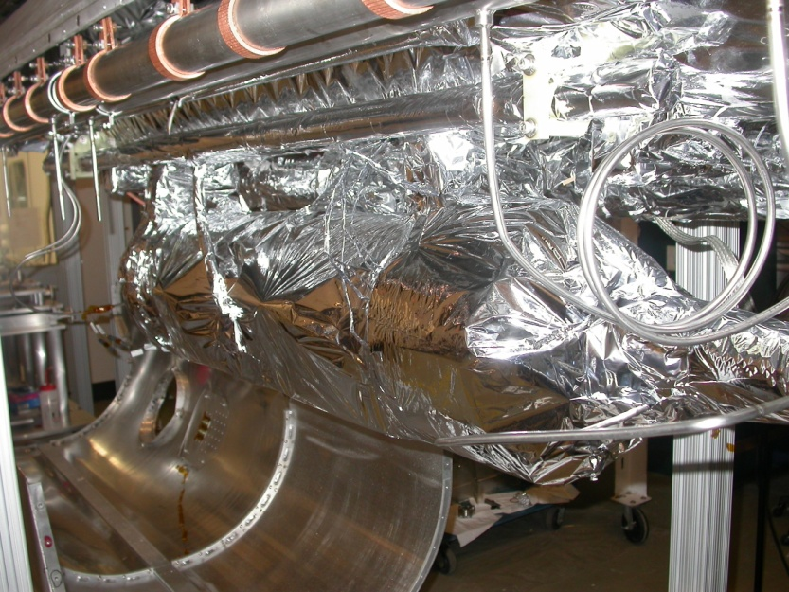
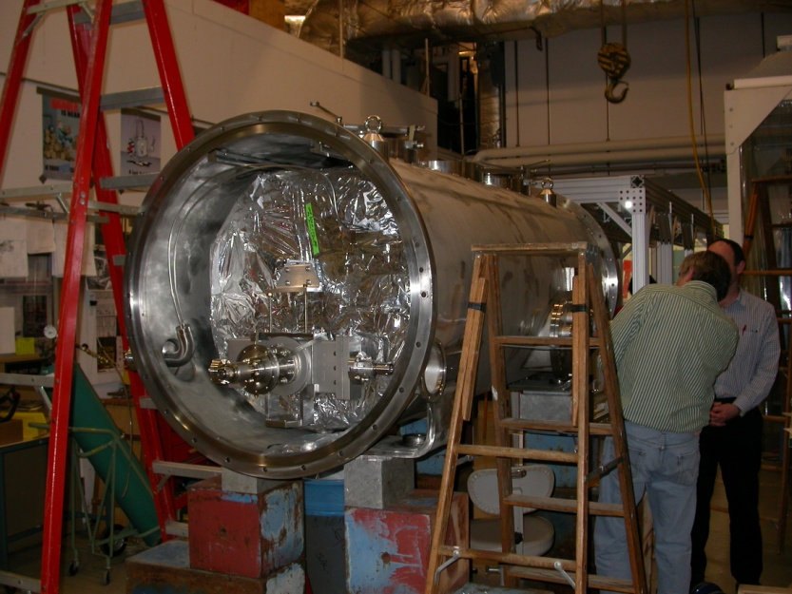
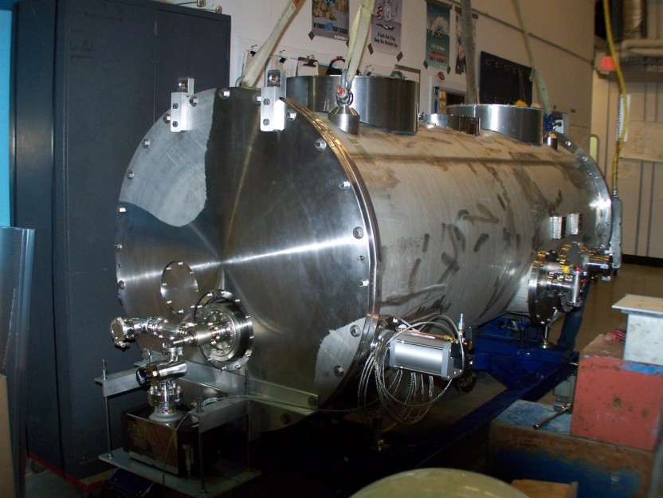
HTC Assembly

Slide 8
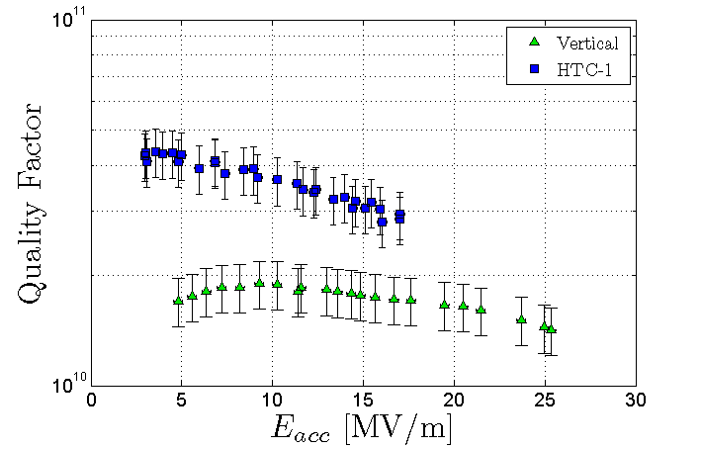
HTC-1 Results
Comparison of Vertical and HTC-1 test of ERL7-1
HTC-1 Results
Cool Down
Cavity received only HPR and helium tank welding between vertical and horizontal tests.
Q₀ significantly increased in the cryomodule compared with vertical test.
Thermal cycling caused Q₀ to increase.
Note: all cool downs are slow by vertical test standards: ~1 K/hour

Slide 9
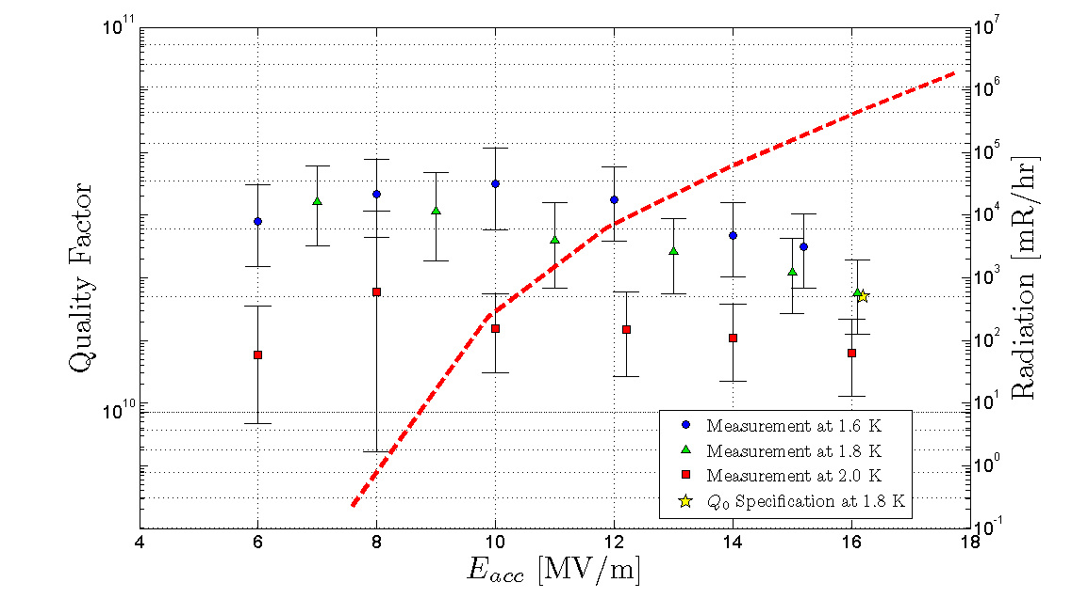
HTC-2 Results
Cavity again met specification in the cryomodule.
Large amounts of radiation (10 kR/hr) were seen at higher fields.
Input coupler installation resulted in a field emitter that limited cavity Q₀.

Slide 10
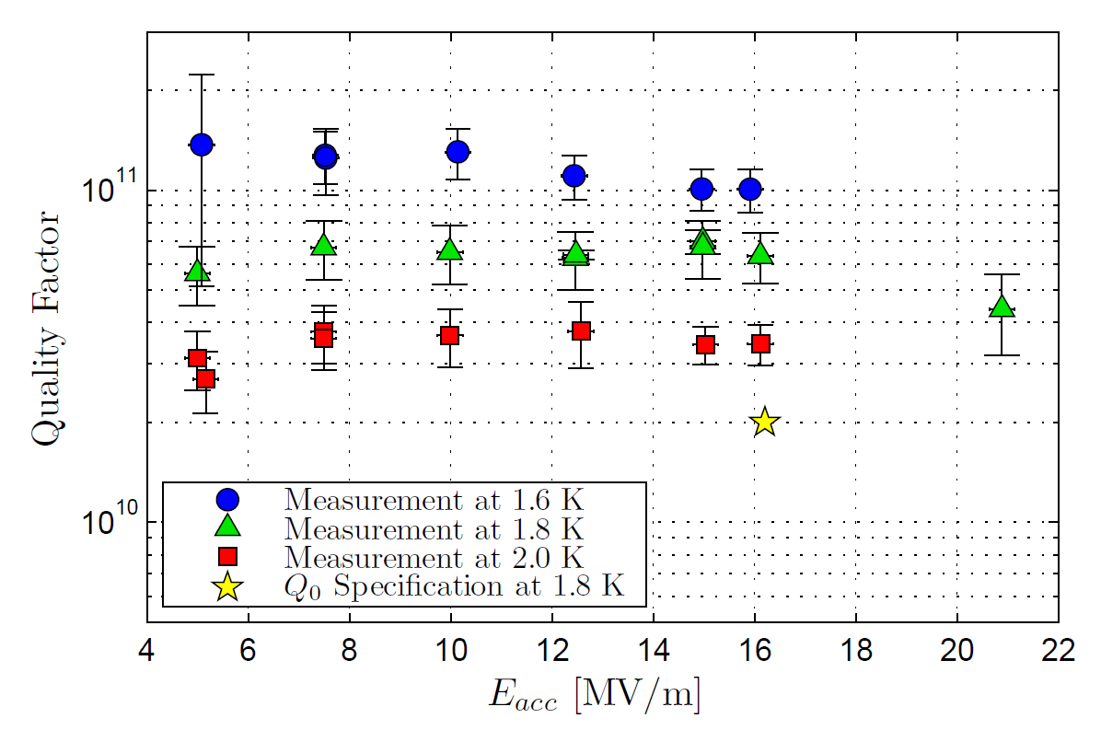
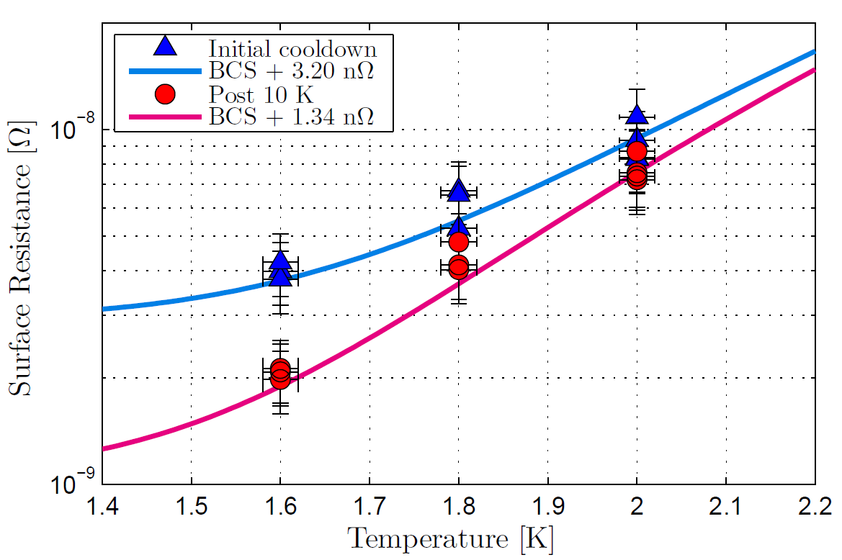
HTC-3 Results
Initial Cooldown at 16.2 MV/m
Q₀(2.0 K) = 2.5 x 10¹⁰
Q₀(1.8 K) = 3.5 x 10¹⁰
Q₀(1.6 K) = 5.0 x 10¹⁰
10 K thermal cycle at 16.2 MV/m
Q₀(2.0 K) = 3.5 x 10¹⁰
Q₀(1.8 K) = 6.0 x 10¹⁰
Q₀(1.6 K) = 10.0 x 10¹⁰

Slide 11
Conclusions
Cavity performance in the cryomodule exceeded performance in vertical test.
Measurements in horizontal test cryomodule demonstrated world record quality factors:
Q₀(1.6 K, 16.2 MV/m) ≥ 10¹¹
Exceeded 1.8 K spec by 3X – aimed for 2x10¹⁰, got 6x10¹⁰.
10 K thermal cycling in cryomodule resulted in a 3X reduction in residual resistance (3.20->1.34 nΩ).
We’ve demonstrated that the Cornell ERL Q₀ specification of 2x10¹⁰ at 1.8 K and 16 MV/m can be repeatedly met in a cryomodule.

